Slide 1
The Single Responsibility Principle
(SRP)
based on an article of that title by Robert Martin

Slide 2
Single Responsibility Principle
Each responsibility is a reason to change a class:
  A Class should have only one reason to change.
How to know whether a class has many responsibilities?
  The class’s responsibility is described using several “and”s…
SRP violation Reduces class cohesion

Slide 3
Single-Responsibility Principle (SRP)
Also referred to as “modularity”
If a class has two responsibilities:
  The code for these get coupled, and often need to change together.
How to solve this problem?
Solution hint: delegate!

Slide 4
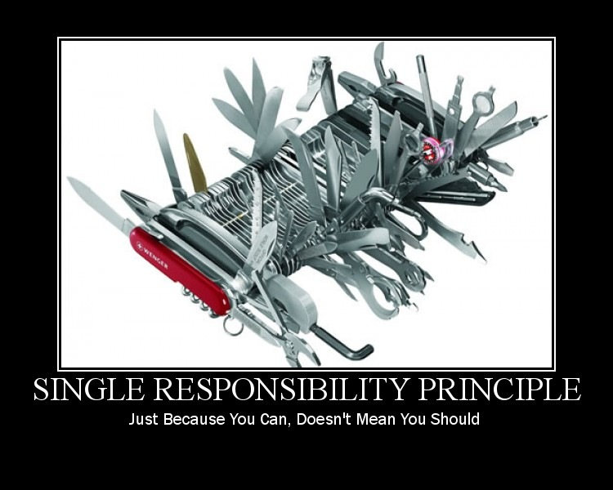

Slide 5

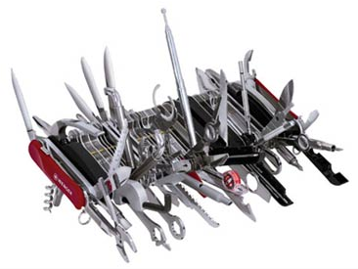
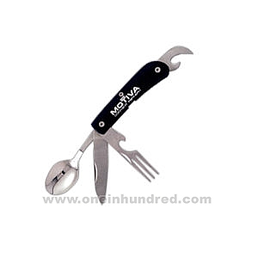
SRP: Main Idea…

Slide 6
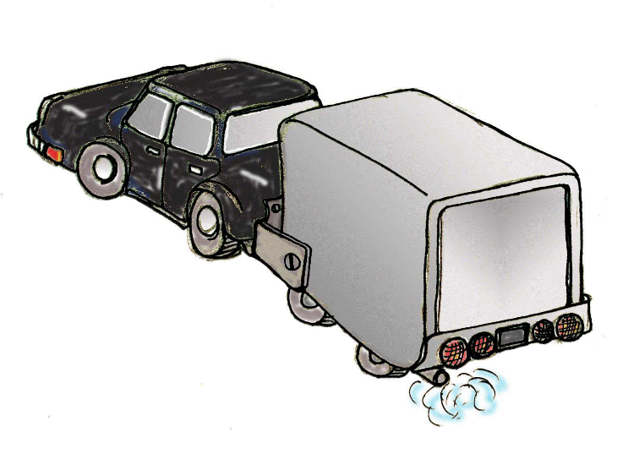
Why SRP?
Single Responsibility = increased cohesion
Violation leads to needless dependencies:
  More reasons for changes.
Also becomes harder to reuse:
  Rigidity, Immobility

Slide 7
Single Responsibility: First Example
Student
name
address
grades
feePayable
calculateGPA
calculateFee
student name
student address
grades
Semester fee payable
Why might this class definition change?
Notes:
Two answers: Student definition changes – or – we decide to store the student in a different way (DB? Network? Somewhere else)

Slide 8
SRP: 2nd Example
public interface Worker {
public void eat();
public void work();
}
public class OfficeWorker implements Worker{
public void work() {// ....work 8 hrs}
public void eat() {// .... eat in lunch break}
}
How to add a robot?
public class RobotWorker implements Worker {
public void work() {
// Do work }
public void eat() {
    throw new NotImplementedException();
}
}

Slide 9
SRP – Fix!
public interface Worker {
public void work();
}
public interface Eater{
public void eat();
}
public class OfficeWorker implements Worker, Eater{ … }
public class RobotWorker implements Worker{ …}
Now each interface has only one purpose
Notes:
Got here 11/20/2008

Slide 10
SRP: 3rd Example
Rectangle has 2 responsibilities
Computation
Geometry
Algorithm
Rectangle
Draw()
Area()
Graphics
Application
Rectangle
Draw()
Area()
Dependency
GUI
Changes to Rectangle may be needed from two unrelated sources.
1. Computational Geometry Application: Need area function to return result of type double.
2. Graphics Application (GA).
Need draw() in Windows 10 in addition to X Windows.
A change from either source will cause both the applications to recompile.

Slide 11
SRP: Initial Solution
Geometric
Rectangle
Area()
Graphic
Rectangle
Draw()
Graphics
Application
Comp Geo
Algorithm
GUI
Dependency
CGA is no longer dependent on Graphic Rectangle
Any change caused by graphics application no longer requires CGA to be recompiled.
However, any changes from the CGA side may cause GA to be recompiled.

Slide 12
Now How to Break Dependency of Graphic Rectangle on Geometric Rectangle?
<<Interface>> Geometric
Rectangle
Area()
Comp Geo
Algorithm
Graphic
Rectangle
Draw()
Graphics
Application
Geometric
Rectangle
Area()
GUI
Dependency

Slide 13
SRP: 4th Example
Shape
Line
draw()
area()
Rectangle
draw()
area();

Slide 14
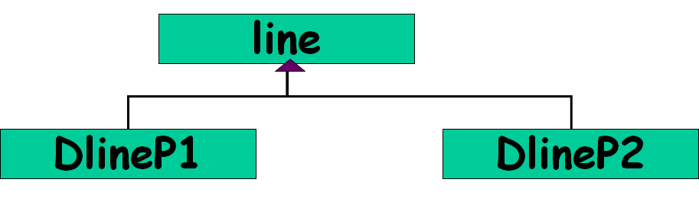
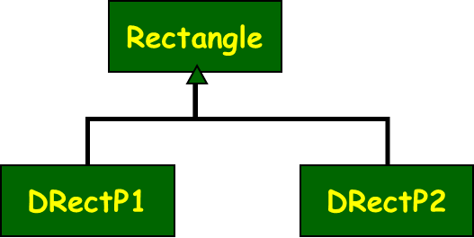
Now assume we need to support cheap low resolution displays and high resolution gaming displays…
Drawing Line: 2 APIs Needed
Low resolution: dlineP1(x1, y1, x2, y2)
High resolution: dlineP2(x1, x2, y1, y2)
Similar for rectangle…

Slide 15
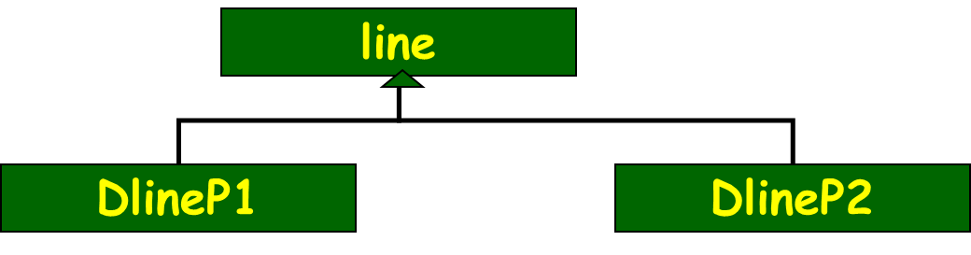
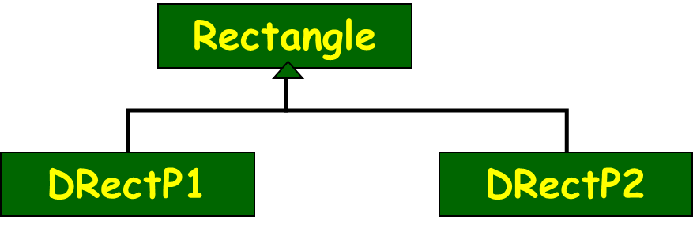
Obvious Solution…
Now need to support transient and animation views…

Slide 16
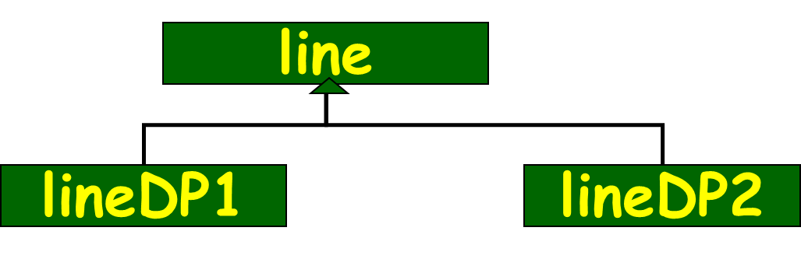
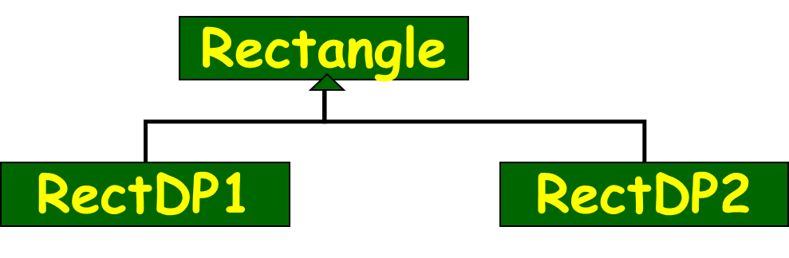
Obvious Solution…
Transient
Animation
Transient
Animation
Transient
Animation
Transient
Animation

Slide 17
Obvious Solution: Analysis
Advantages
  Simple to implement
  Simple to understand
Disadvantages
  When number of shapes and drawing features increase:
    The number of classes becomes LARGE (nXm)
  Cohesion is low

Slide 18
Pattern Solution to the Problem: Bridge
defines the interface
shapes to draw
Shape
Drawer
Line
Triangle
Hi Res
Low Res
“adapters” for specific
drawing interfaces

Slide 19
Bridge Pattern
Skip at the moment
  Problem:
  Decouple an abstraction from its implementation, so that the two can vary independently…
Also known as: Handle/Body pattern

Slide 20
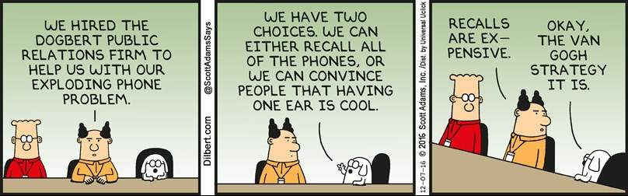

Slide 21
SRP: A Reflection on Causes
Often inheritance is used to extend a class along unrelated dimensions:
    Reduces method cohesion and violates SRP …
Student
UG
PG
PhD
resi
day
resi
day
rust
NR
rust
NR
rust
NR

Slide 22
SRP: A Reflection on Causes
Let’s say need arises to have different types of bank Accounts:
  First, based on account type: Cash Account, Credit Account
  Second, based on customer type: Individual Account, Institutional Account
These are two dimensions,
  E.g. Individual Cash Account, Individual Credit Account, etc.
  Often implemented as inheritance

Slide 23
Inheritance Diamonds…
Do not inherit unrelated dimensions!
Account
Cash Account
Credit
Account
Individual Account
Institutional Account
Individual Cash Account
Two more classes here…
Individual Credit Account

Slide 24
Solution: Separate Abstractions and Encapsulate Variability
owner
Customer
Account
1..*
Cash
Account
Credit
Account
Individual
Customer
Institutional
Customer

Slide 25
Exercise: Suggest Better Design
Person
Name
Address
Passenger
Agent
FrequentFlyerID
Reservation
Password
AuthorizationLevel
AgentPassenger

Slide 26
Composition to rescue!
(Inferior solution)
Passenger
Frequent Flyer ID
Reservation
Person
Name
Address
Passenger
Agent
Agent
Password
Authorization level

Slide 27
Better Solution!
Person
Name
Address
Role
Person Role
<<interface>>
Agent
Passenger
Password
Authorization level
Frequent Flyer ID
Reservation

Slide 28
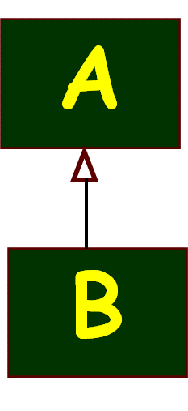
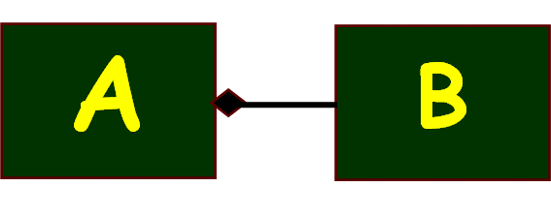
Inheritance versus Delegation
Two most common techniques for reuse
  Class inheritance
    white-box reuse: Add incremental functionality
  Object Delegation
    black-box reuse: New functionality is obtained by invoking the functionality of some object
Class inheritance: advantages
    Easier implementation
    Static: Easier understanding

Slide 29
Class inheritance: disadvantages
Inherited features can’t be changed at run time.
Even when you’re only trying to reuse the base class features in a subclass…
  Bugs can appear in base class features.
Subclasses access Parent classes’ internal data:
  breaks encapsulation

Slide 30
Delegation
Delegation can take place dynamically at run time:
  Does not break encapsulation
A delegate object can be replaced at run time.
Helps to keep server class encapsulated and focused on one task.
  Favor object delegation over class inheritance.

Slide 31
Favour Delegation over inheritance
inheritance
A
A
B
has a
isa
Delegation
B
BLACK box reuse
WHITE box reuse

Slide 32
Favor Delegation over inheritance
inheritance
Delegation
A
A
has a
B
isa
Caveat: sometimes inheritance is the right thing:
it gives us polymorphism
B
BLACK box reuse
WHITE box reuse

Slide 33
Dependency Inversion Principle
based on an article of that title by Robert Martin

Slide 34
DIP: Statement
“Depend on Abstractions-- not on concretions”.
High level components should not depend upon low level components.
  Abstractions should not depend upon details… Details should depend upon abstractions…
Why?
  High-level concepts are more stable than low-level implementations.
High Level
Low Level

Slide 35
DIP
The goal is to limit dependence on the aspects of a design/implementation that may change.
There are times when dependency on concrete implementations is OK.
  If the implementation is never going to change--- then no problem…
  If going to change, then attempt to prevent dependencies on relatively lower level classes.

Slide 36
DIP: An Explanation
Whenever a certain functionality is implemented:
  It can be divided into high level and low level parts.
The high level parts usually represent the concept in the activity:
  Whereas the low level parts implement the details of the high level activities.
  Low level parts (code) more susceptible to change…
High Level
Low Level

Slide 37
Compute
Log to file
Any Problems?
  High level concept depends on low level details!
  What if we now require to write the log into database? --- Would require changes to Compute class… too bad…
Solution…
Compute
MessageLog Interface
How to know which is a high-level concept?
Gives orders to lower level concepts…
Log to file
Log to database

Slide 38
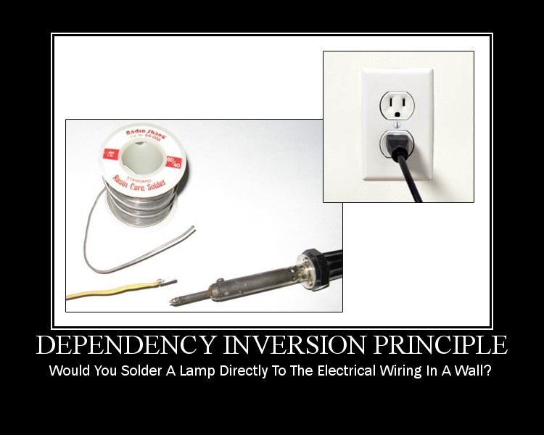
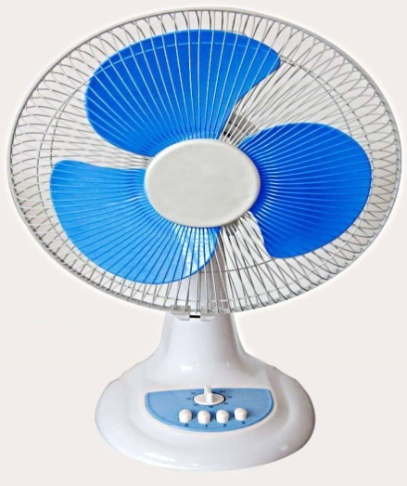
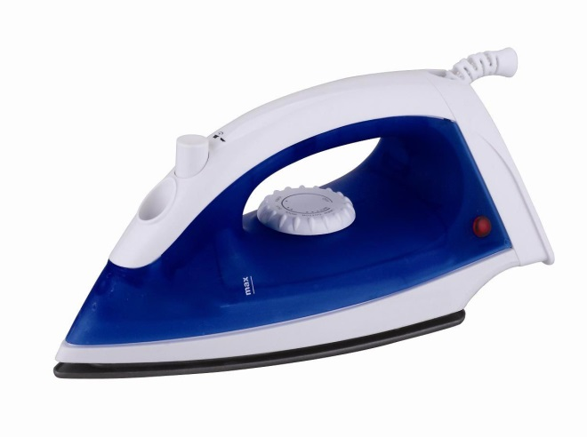
Use standard interfaces (sockets)

Slide 39
Dependency Inversion Principle
Higher level modules should not depend on the concrete lower level modules.
Should depend on abstractions
  Interfaces or Abstract classes
Complex systems should be structured into layers.
  But if that is not done carefully -- the top levels depend on the lower levels… Warranting unnecessary changes…

Slide 40
DIP: Another Example ...
Car
Petrol
Engine
For cost saving, suppose you want to fit your Car with a CNG Engine:
  Too bad if alterations needed to the car…
  Should only change the engine…
  How to achieve?
  Car should be able to interface to any standard engine …

Slide 41
With DIP …
Car
<interface>>
Engine
Petrol
Engine
CNG
Engine
A higher level class must not depend on some other lower concrete class!
It must depend only on an interface ...

Slide 42
Removing Dependency
Dependency vanishes when changed from concrete to abstract ...
Client is closed to changes to the implementation of the Server.
Server is open for extension through creation of new Server implementations…
Without AbsServer the Client is open to changes in Server.
Client
Client
- myServer : AbsServer
- myServer : Server
+doSomthing()
+doSomthing()
<<interface>>
AbsServer
+ serve() : Result
Server
+ serve() : Result
Server
+ serve() : Result

Slide 43
Summary of Requirement of DIP
No concrete class should directly refer to a class that is likely to change.

Slide 44
Depend On Abstractions
High-level modules should not depend on low-level modules.
  Should depend on abstractions.
Abstractions should not depend on details.
  Details should depend on abstractions.

Slide 45
Is DIP Related to OCP?
For both: Depend on abstraction not implementation…
  Or equivalently “design to interfaces”
OCP:
  Use abstractions as an organizing principle.
  Extensibility is then achieved by different realizations of the abstraction…
DIP:
  Larger context: Partition solution to layers…
  Rely on abstractions and not the concrete objects.

Slide 46
DIP Implications…
Layering
Interface based programming
Separated Interface:
  Put interface in separate package than implementation
Dependency Injection

Slide 47
Plain old dependency creation
Example:
public class Foo {
private IBar bar;
private IBaz baz;
public Foo() {
bar = new SomeBar();
baz = new SomeBaz();
}
}
Cons
  Class needs changes when any of it’s dependencies change.
  Hard to change behavior without changing code
  Hard to test as you must also test it with all that it depends. Cannot use mocks.
Pros
  Easy to understand

Slide 48
First Solution: Service Locator
Example:
public class Foo {
private IBar bar;
private IServiceLocator locator;
public Foo(IServiceLocator locator_) {
locator = locator_;
bar = locator.Get();
}
}
Cons
  The class depends upon the service locator
  You must still get the locator to the class – either statically (yuk) or via… some sort of injection like mechanism
Pros
  Easy to understand
  Testable
  Flexible
  Extensible
  Enforces separation of interface from implementation

Slide 49
Dependency Injection: Inversion of Control
Example:
public class Foo {
private IBar bar;
private IBaz baz;
public Foo(IBar bar_, IBaz baz_) {
bar = bar_;
baz = baz_;
}
}
Cons
  You must create dependencies to pass along
Pros
  Easy to understand
  Testable
  Flexible
  Extensible
  Enforces separation of interface from implementation
  Code is simple and clear

Slide 50
What is Dependency Injection?
The ability to supply (inject) an external dependency into a software component as per requirement.
Types of Dependency Injection:
  Constructor (Most popular)
  Setter
  Interface

Slide 51
Dependency Injection
Description:
Allows injection of objects into a class, rather than relying on class to create the object
Responsibility for object creation and object linking is removed from the objects
Seeks to establish a level of abstraction via a public interface, and to remove dependency on components.
Martin Fowler described three main styles of dependency injection.
Constructor Injection: A constructor is used to decide how to inject ‘A’ implementation into the ‘B’ class. For this to work, B class needs to declare a constructor that includes everything it needs injected.
Setter Injection: define setter method that will accept the injection
Interface Injection: by defining an interface that performs the injection
Skip
Constructor Injection | Setter Injection | Interface Injection
public class MovieLister... public MovieLister(MovieFinder finder) { this.finder = finder; } | public class MovieLister... private MovieFinder finder; public void setFinder(MovieFinder finder) { this.finder = finder; } | public interface InjectFinder { void injectFinder(MovieFinder finder); } class MovieLister implements InjectFinder... public void injectFinder(MovieFinder finder) { this.finder = finder; }

Slide 52
Setter Injection
  The component is passive
  Someone injects the dependency
Controller
+ seMyView(view)

Slide 53
Constructor Injection
  “Always” initialized
  Better dependency visibility
Controller
+ Controller (view)

Slide 54
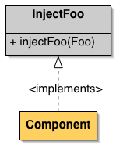
Interface Injection
  Variation on setter injection

Slide 55
Setter Injection
public class TextEditor {
private SpellChecker spellChecker;
public void setSpellChecker(SpellChecker spellChecker) {
this.spellChecker = spellChecker;
}
public SpellChecker getSpellChecker() {
return spellChecker;
}
public void spellCheck() {
spellChecker.checkSpelling();
}
}

Slide 56
Method Injection
class AppPoolWatcher{
INofificationAction action = null;
public void Notify(INofificationAction concreteAction, string message){
this.action = concreteAction;
action.ActOnNotification(message);
}
}
Inject the dependency into only the method that uses it.

Slide 57
Dependency Injection Pros & Cons
Pros:
  Loosely Coupled
  Increases Testability
  Inversion of Control
Cons:
  Increases code complexity
  Fresh Developers find it difficult to understand at First
  Complicates understanding the control flow

Slide 58
Why DIP?...
Reduces dependency:
  Abstract interfaces don't change
  If Concrete classes implement interfaces
    Concrete classes can be easily replaced
Increases isolation:
  Decreases rigidity (Increases mobility)
  Increases testability
  Increases maintainability

Slide 59
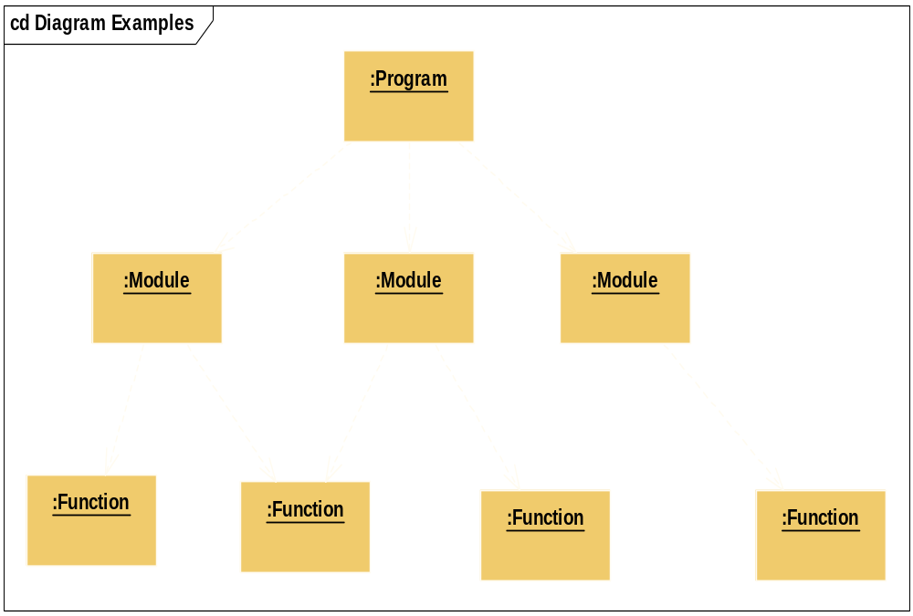
Recall Procedural Design…

Slide 60
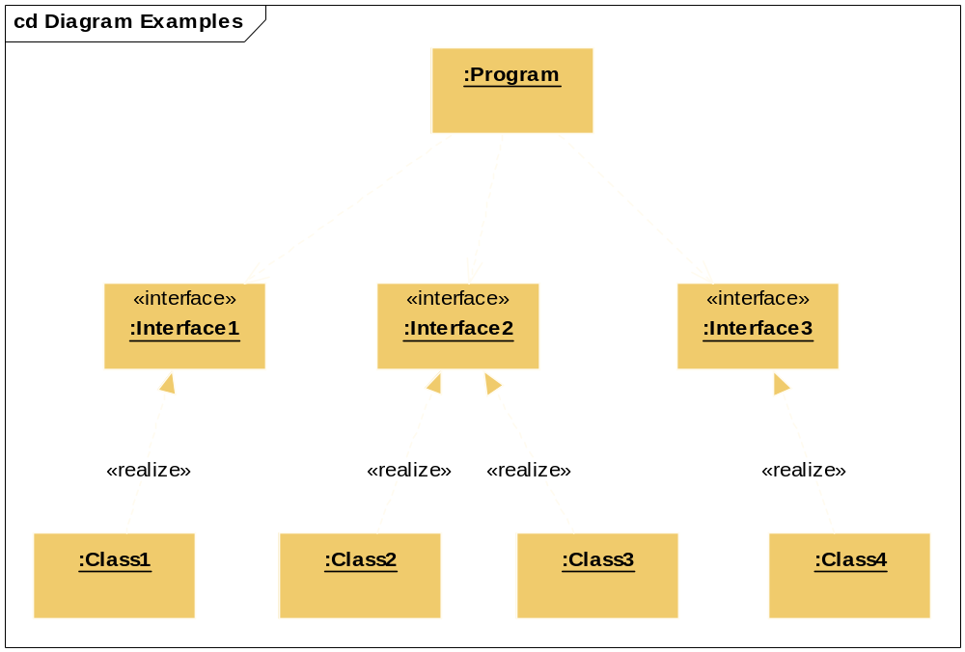
DIP Compliant Design

Slide 61
Procedural vs. OO Design
main
Procedural
Design
mid 1
mid 2
mid 3
Detail
Detail
Detail
Detail
High Level Policy
Abstract/
Interface
Abstract/
Interface
Abstract/ Interface
Object-Oriented
Design
Detailed
Implementation
Detailed
Implementation
Detailed
Implementation

Slide 62
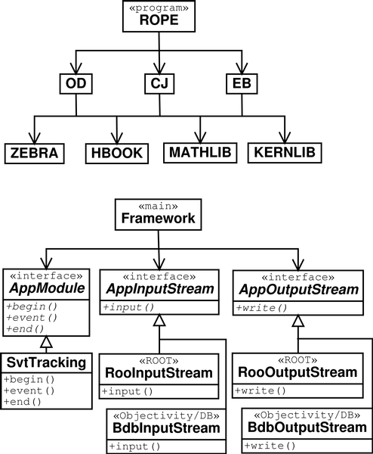
Example DIP and Procedural Design
Procedural:
Call many concrete routines
Dependence on concrete modules
The Framework class depends on interfaces
Possible to change data input /output without disturbing Framework classes

Slide 63
Summary
Dependency Inversion Principle -- statement:
  Components that implement high level policy should not depend on components that implement details.
Instead, should depend on abstractions…

